Slide 1


Slide 2
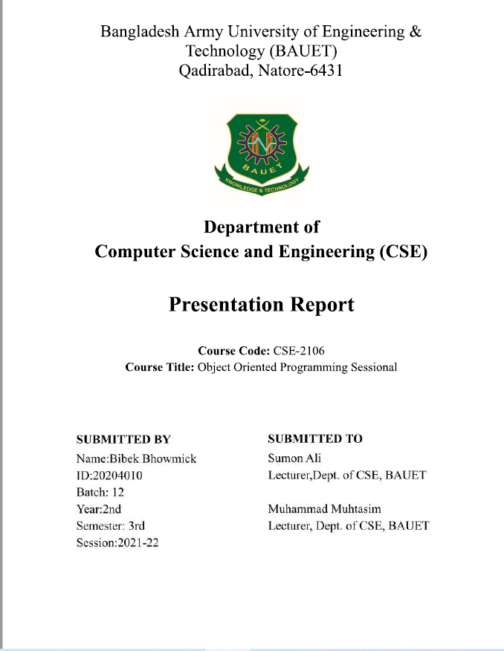
Student Report Management System

Slide 3

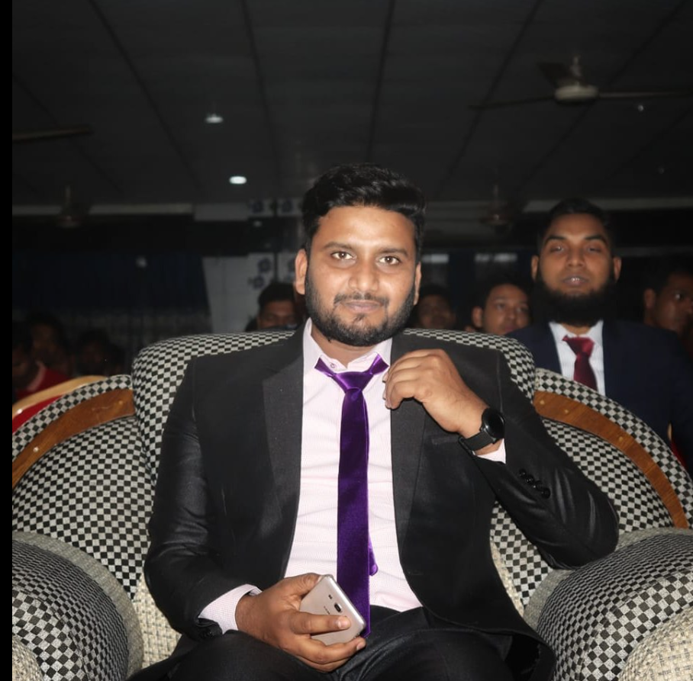
Our respected course teacher
Sumon ali , lecturer department of cse
Muhammad muhtasim , lecturer dept of cse,bauet

Slide 4
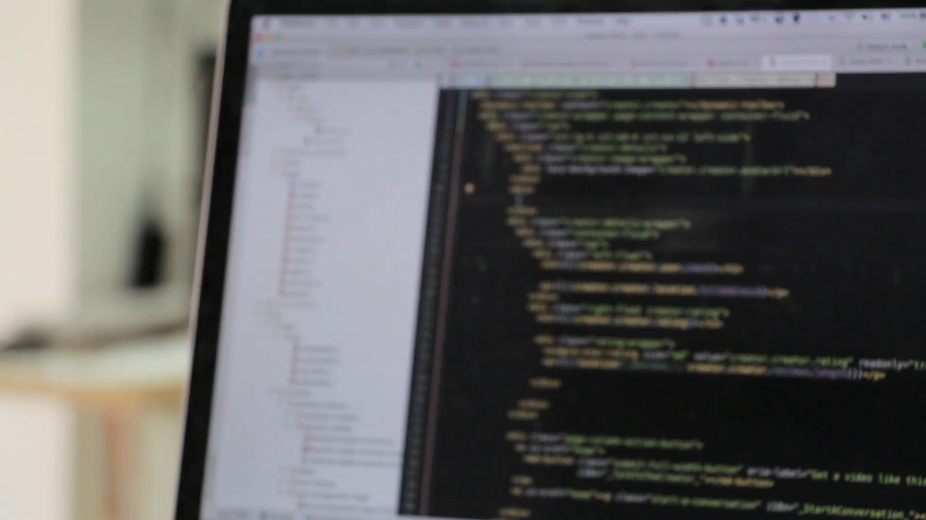
Welcome to Object Oriented Programming

Slide 5
Functions Used!!!!!!!!!!!
new_record()
display_all()
modify_record()
search_data()
delete_record()
show_grade()

Slide 6
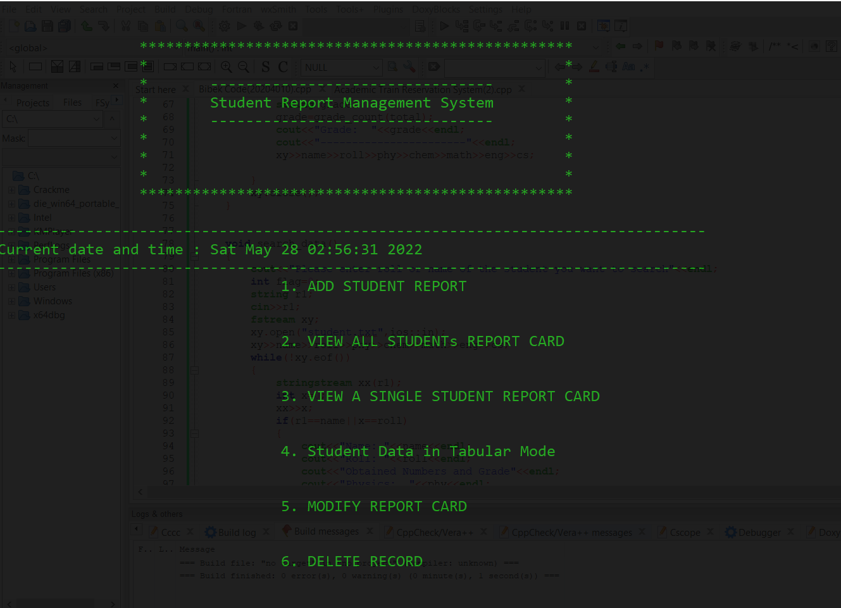
Console Interface

Slide 7

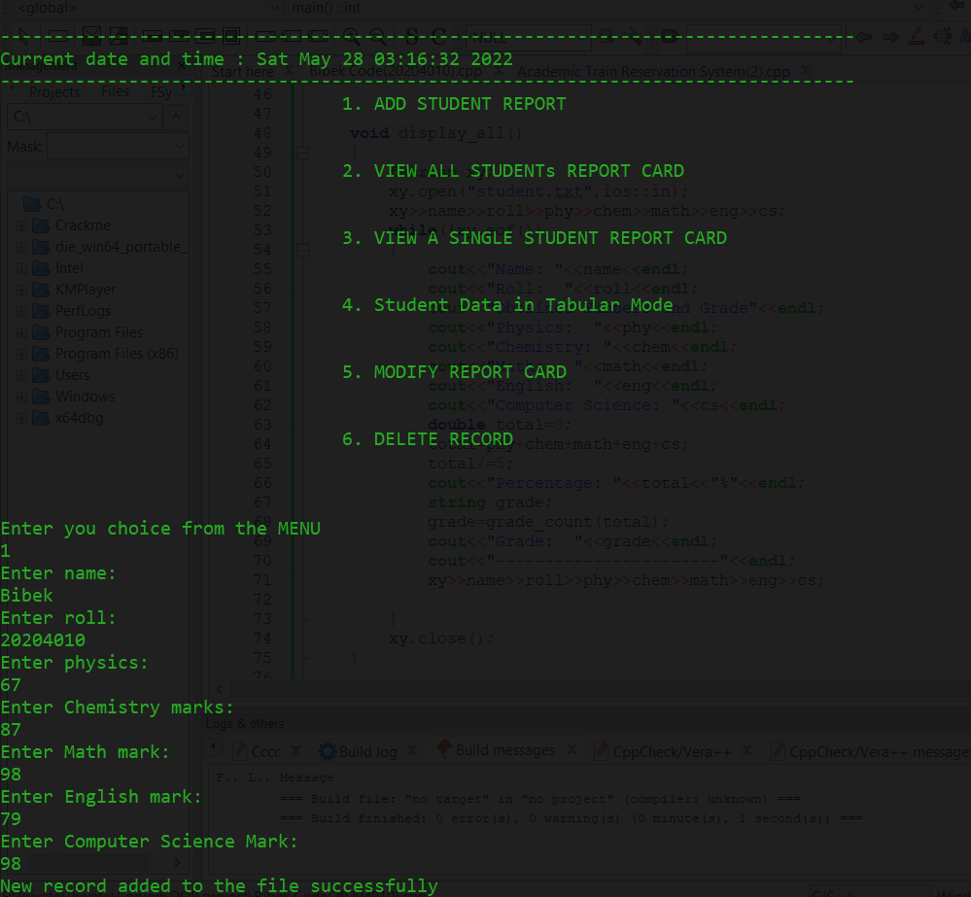
Creating Student Record Interface

Slide 8
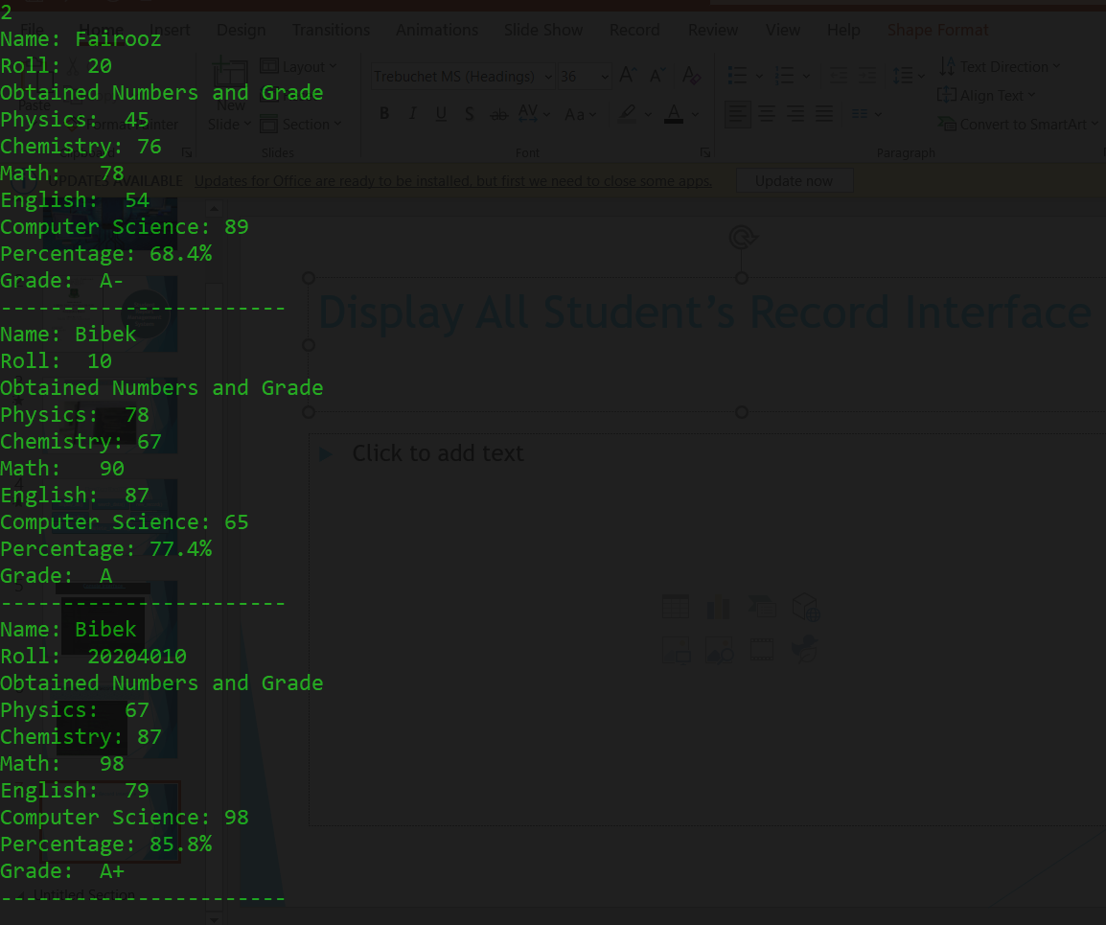
Display All Student’s Record Interface

Slide 9
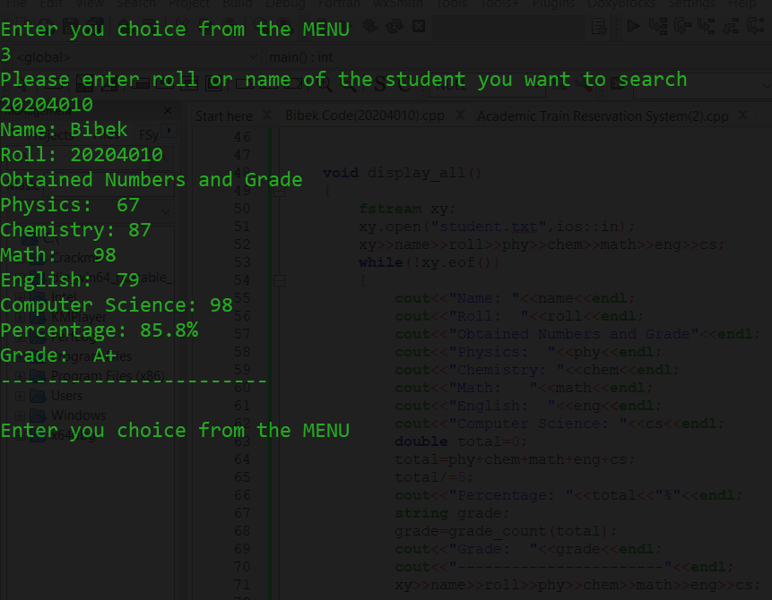
Search a Student’s Record Interface

Slide 10
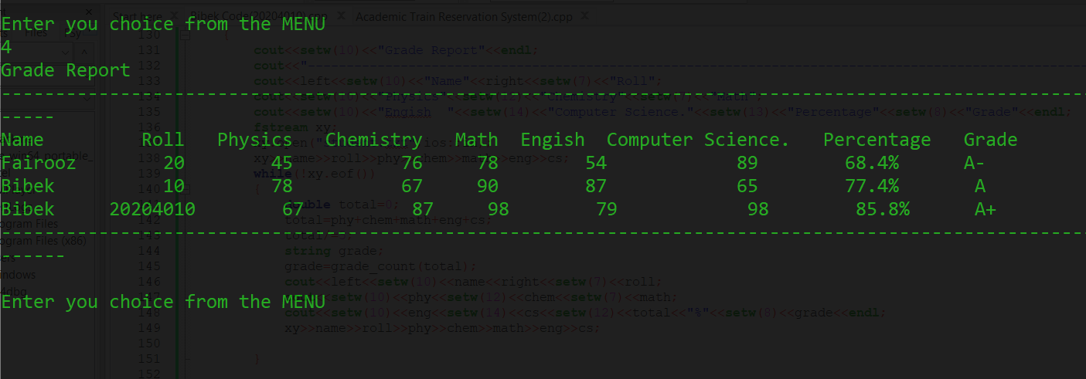
Display Students in Tabular Mode Interface

Slide 11
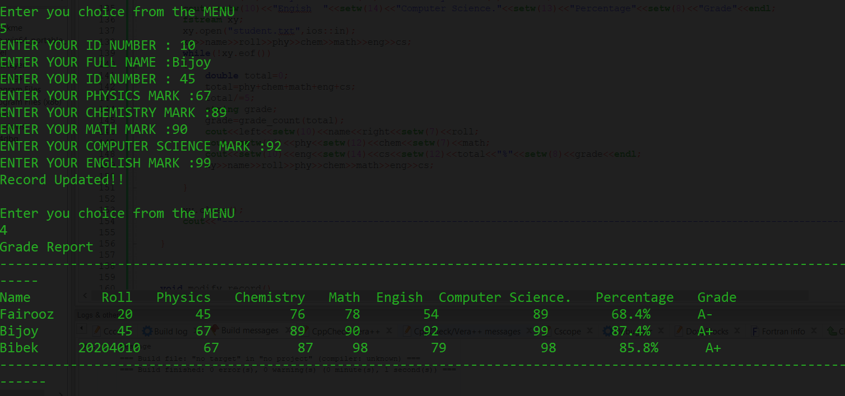
Modify Student Details Interface

Slide 12
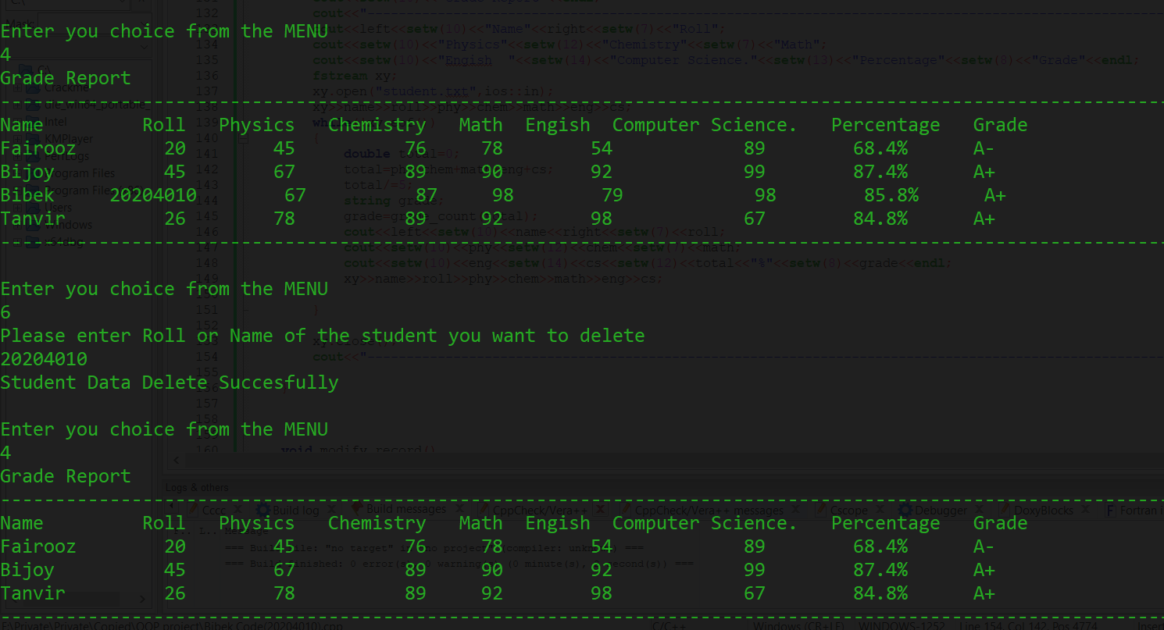
Delete a sTudent details Interface

Slide 13
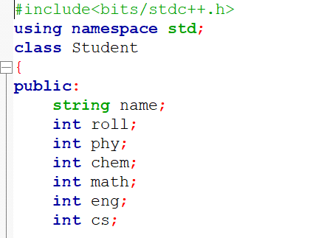
Class member declaration

Slide 14
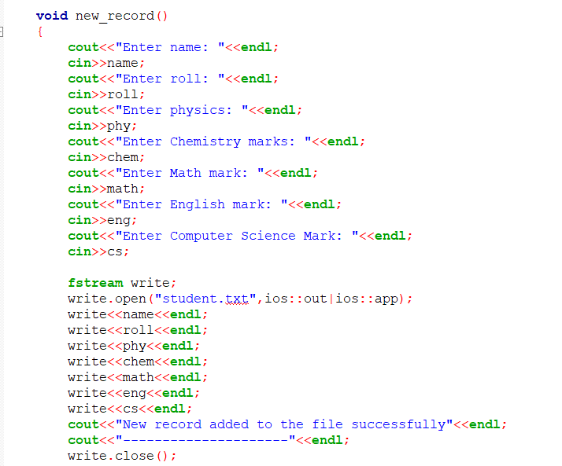
Function to add new student

Slide 15
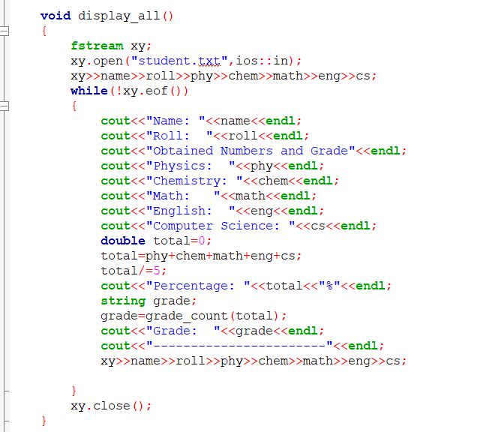
Display all students record

Slide 16
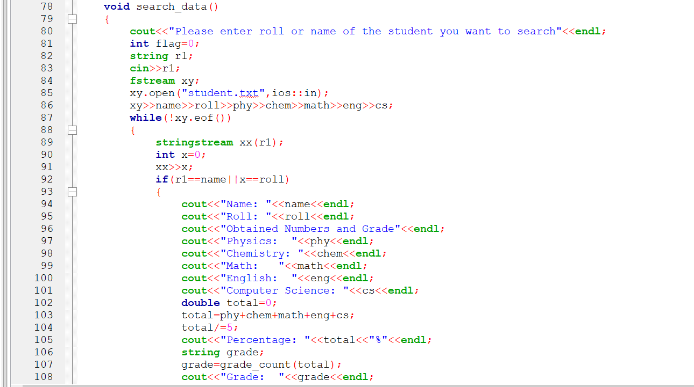
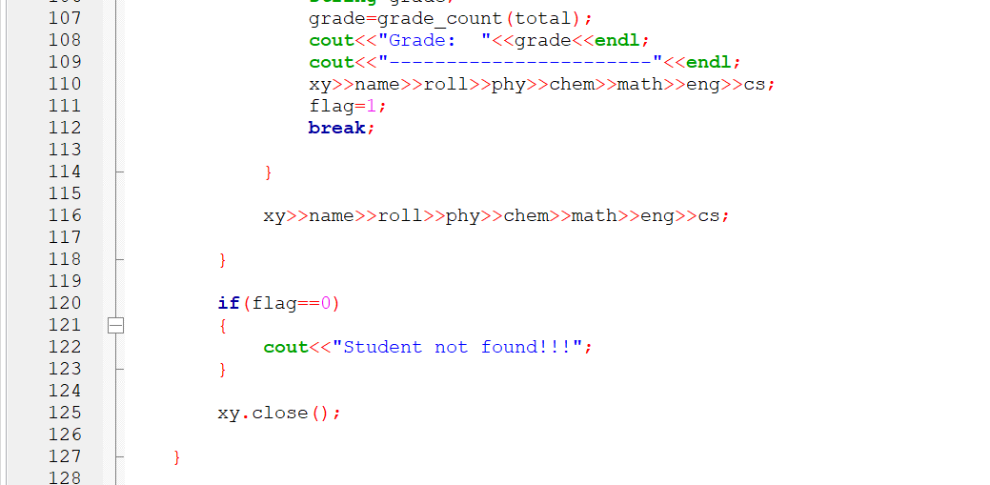
Search a specific student record

Slide 17
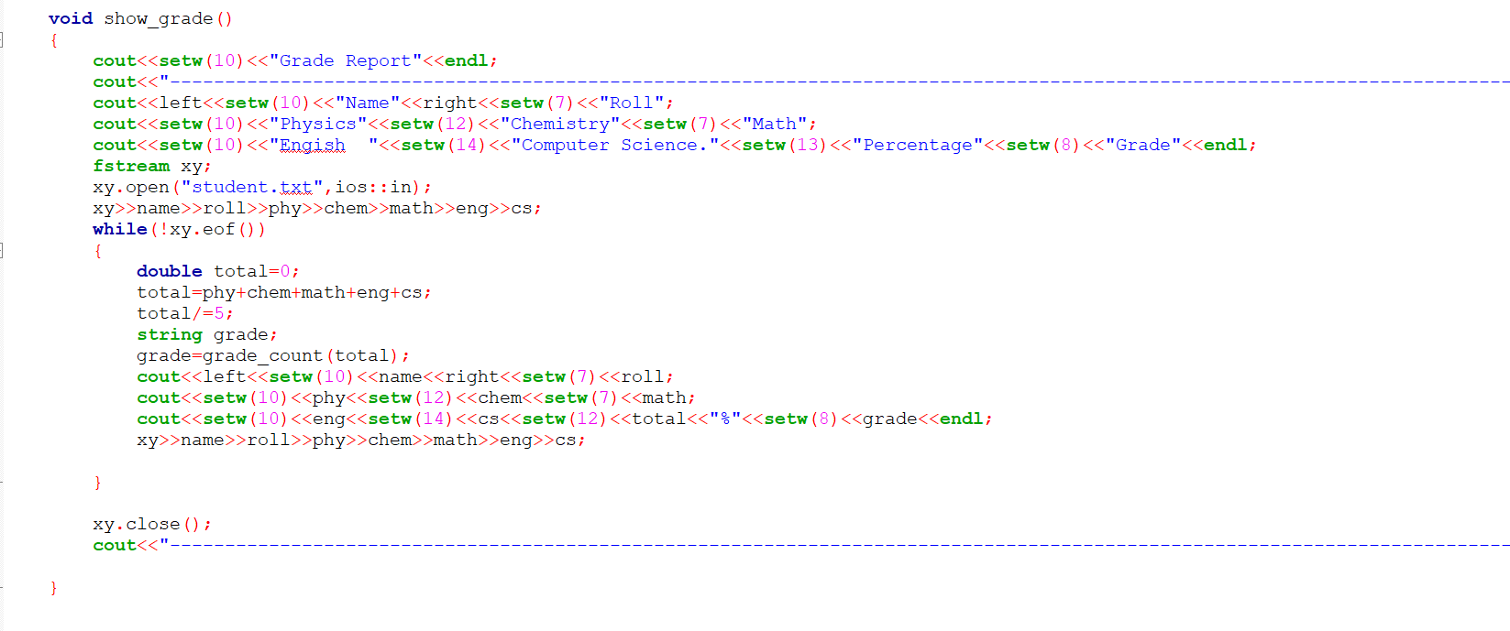
Tabular mode display students

Slide 18
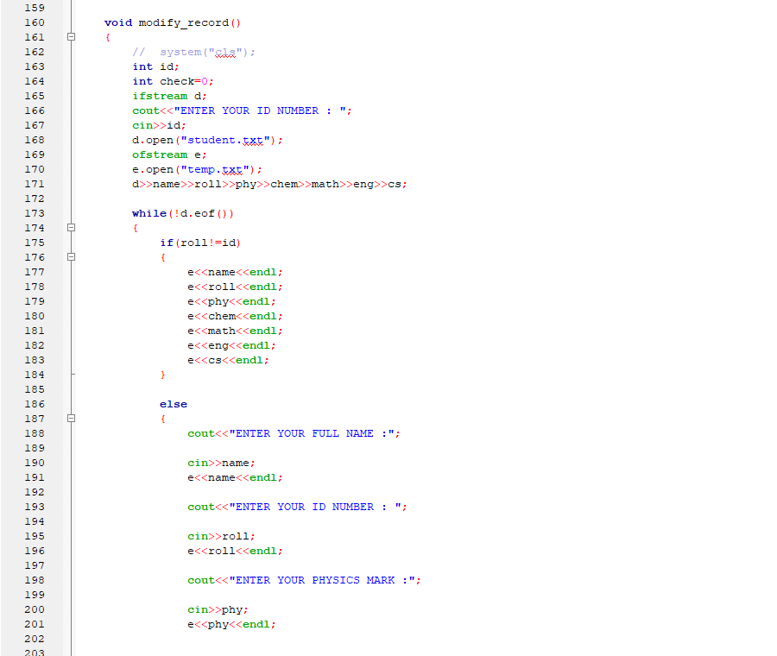
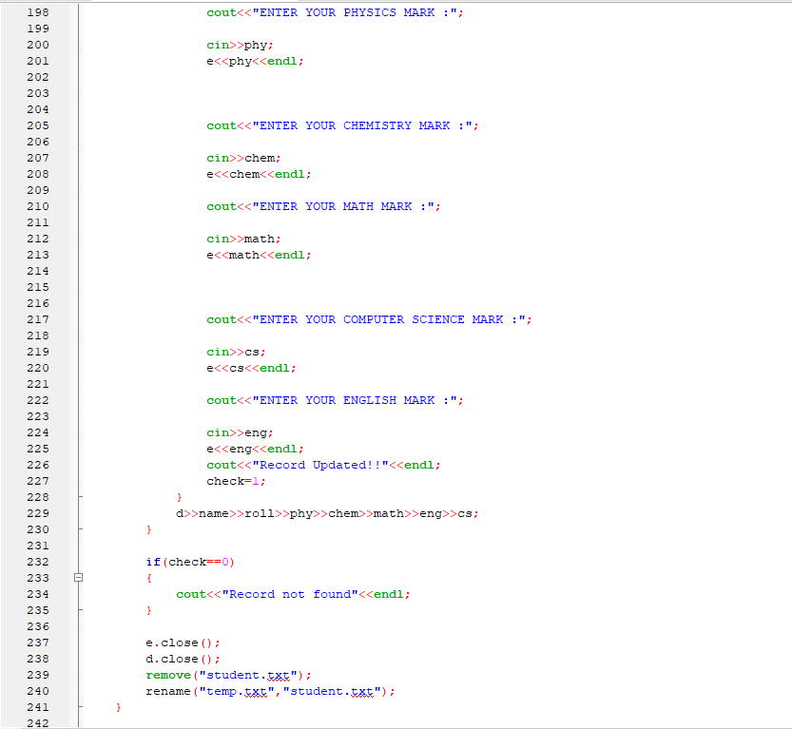
Update student details

Slide 19
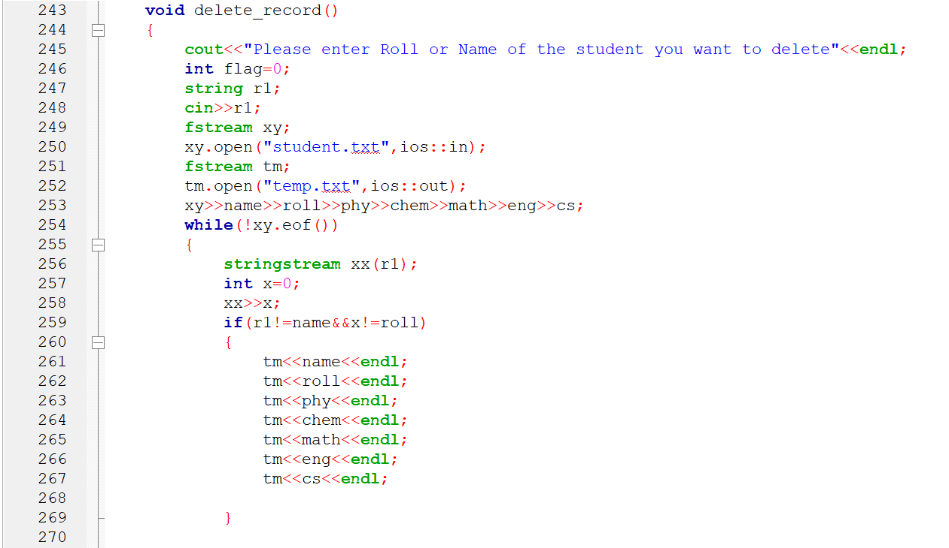
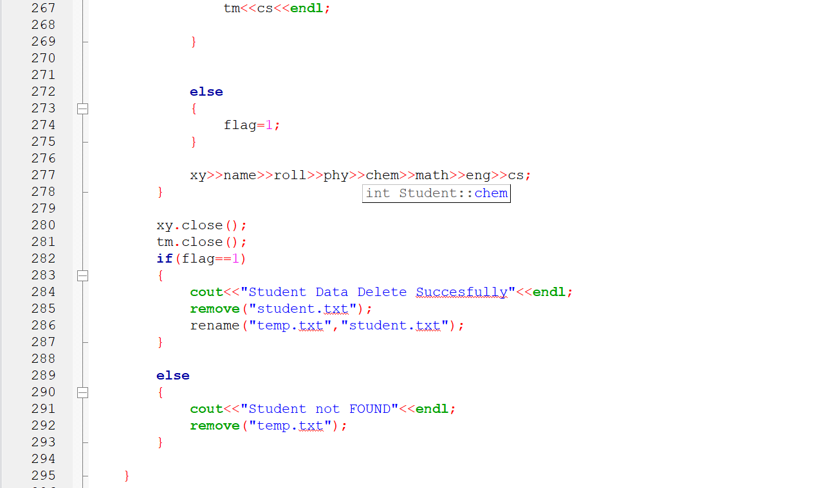
Delete a student record

Slide 20
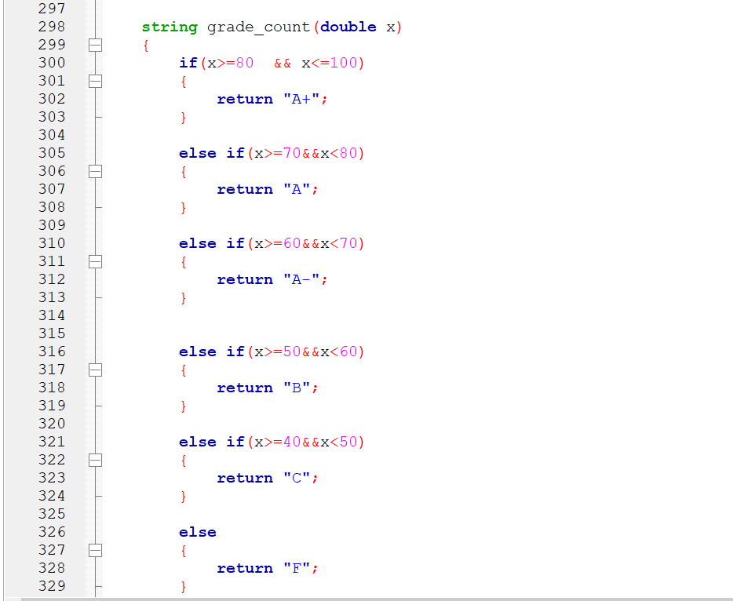
Grade counter program

Slide 21
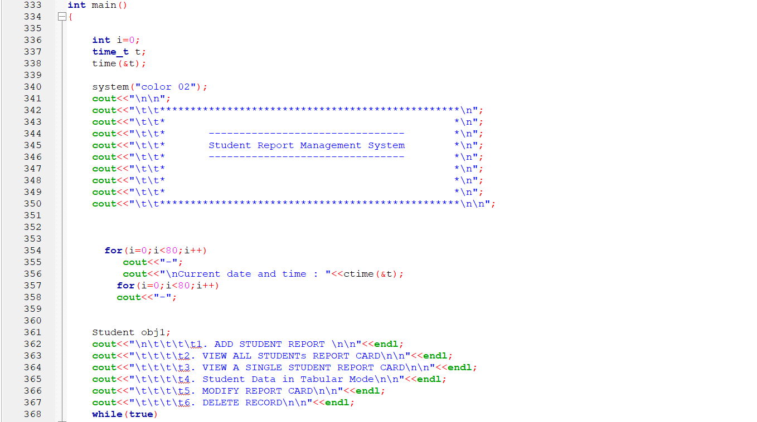
Main function(part-1)

Slide 22
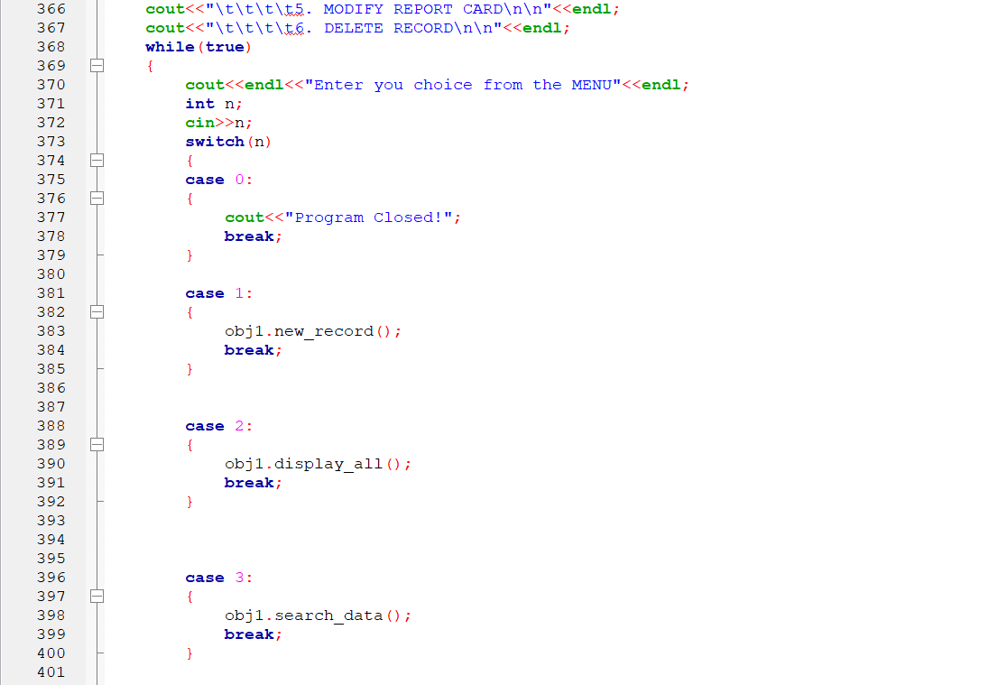
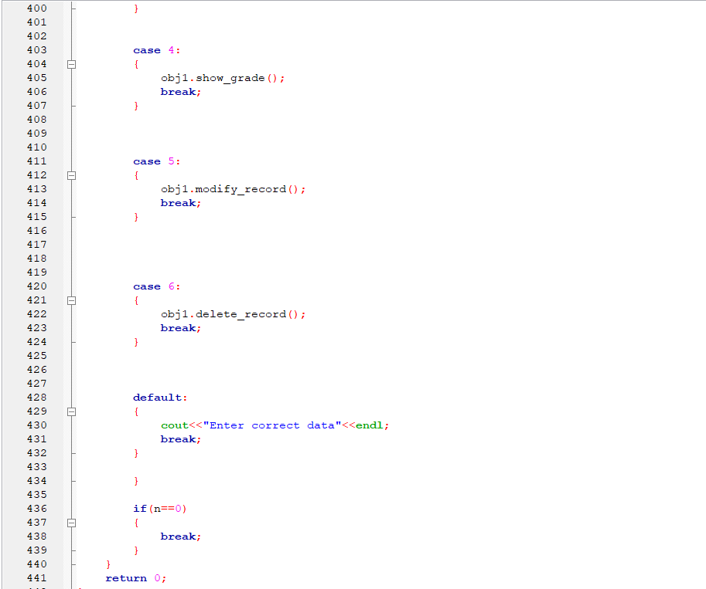
Main function(part-2)

Slide 23
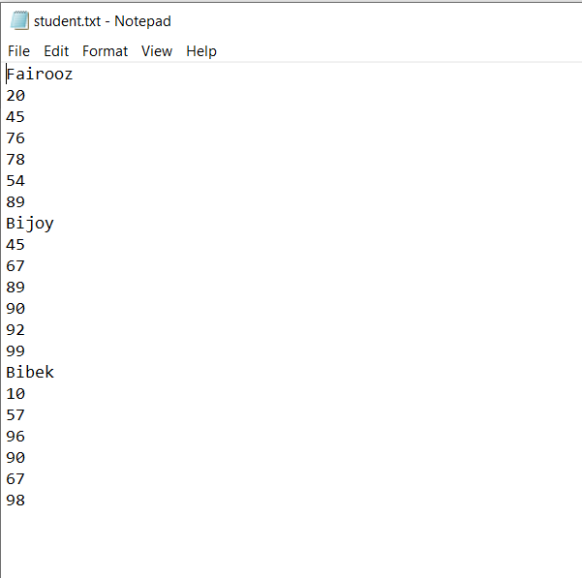
Data stored in a text file

Slide 24

Happy Programming

Slide 25

Thanks to all

